Slide 1
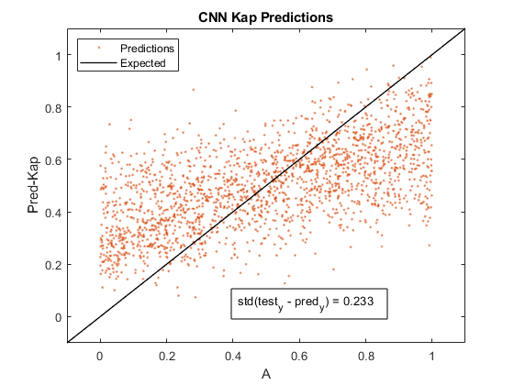
Data10k_Kap
5 5 amplitude
1 1 magnetic field
8 8 energy
400 400 smo
2 2 nu
0 1 Kap
40 40 ld
1 1 ni density
Initial Learn = 0.03

Slide 2
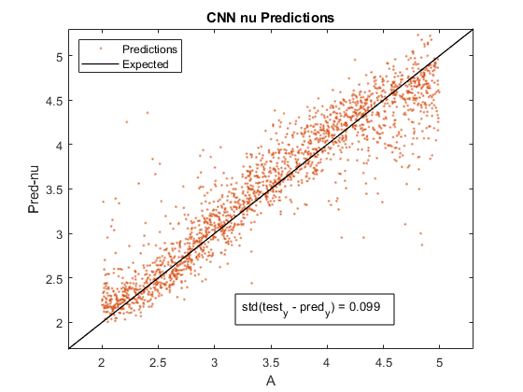
Data10k_Nu
5 5 amplitude
1 1 magnetic field
8 8 energy
400 400 smo
2 5 nu
1 1 Kap
40 40 ld
1 1 ni density
Initial Learn = 0.03

Slide 3
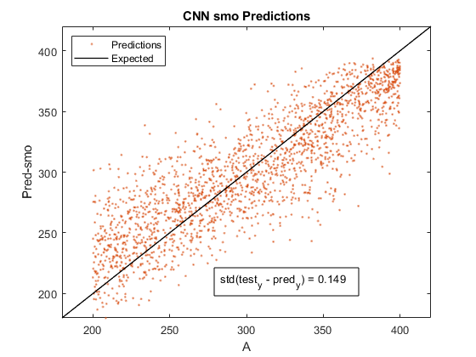
Data10k_Smo
5 5 amplitude
1 1 magnetic field
8 8 energy
200 400 smo
2 2 nu
1 1 Kap
40 40 ld
1 1 ni density
Initial Learn = 0.03

Slide 4
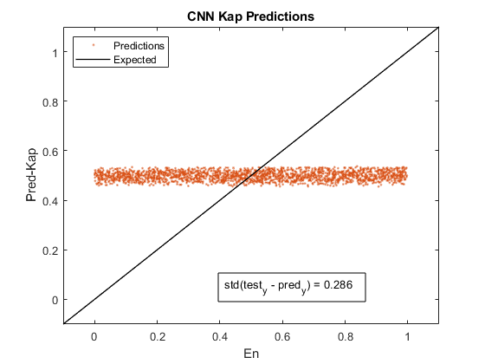
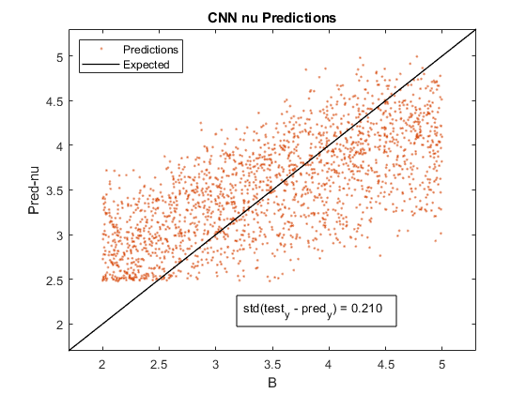
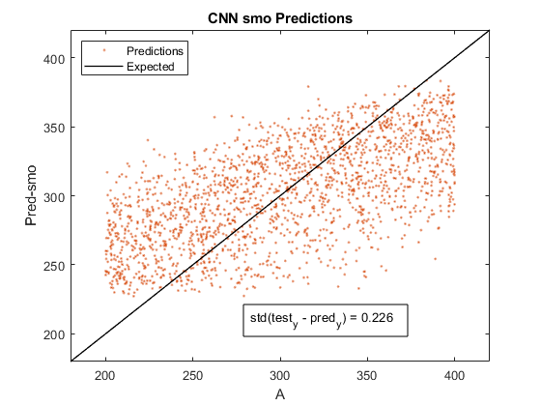
Data10k_SmoNuKap
5 5 amplitude
1 1 magnetic field
8 8 energy
200 400 smo
2 5 nu
0 1 Kap
40 40 ld
0 1 ni density
Initial Learn = 0.03

Slide 5
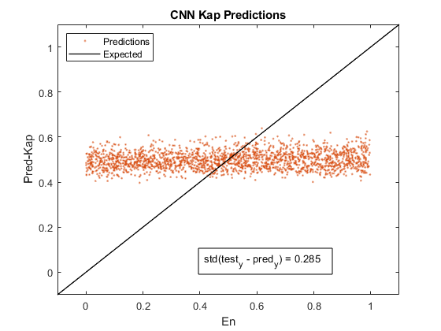
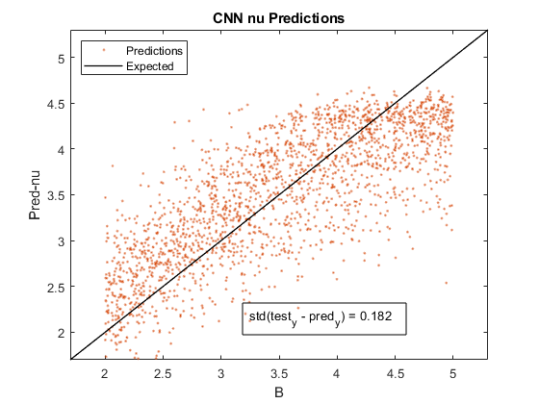
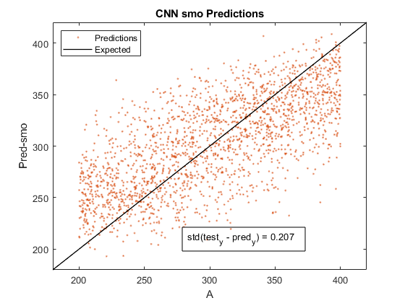
Data10k_SmoNuKap
5 5 amplitude
1 1 magnetic field
8 8 energy
200 400 smo
2 5 nu
0 1 Kap
40 40 ld
0 1 ni density
Initial Learn = 0.1

Slide 6
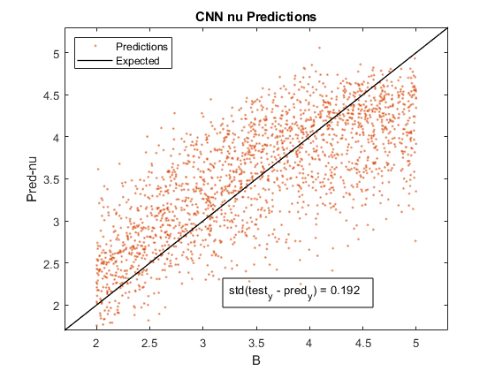

Data10k_SmoNu
5 5 amplitude
1 1 magnetic field
8 8 energy
200 400 smo
2 5 nu
1 1 Kap
40 40 ld
1 1 ni density
Initial Learn = 0.1

Slide 7
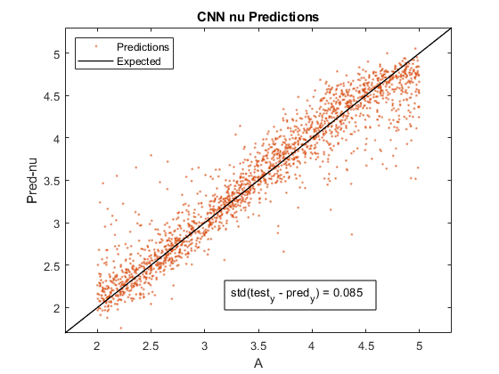
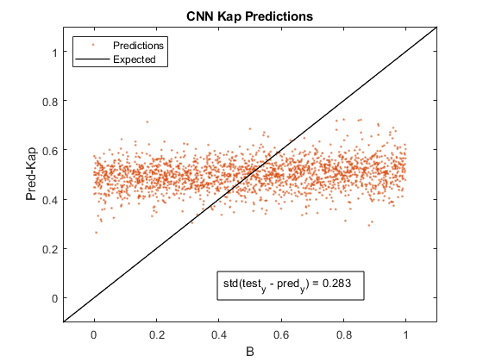
Data10k_NuKap
5 5 amplitude
1 1 magnetic field
8 8 energy
400 400 smo
2 5 nu
0 1 Kap
40 40 ld
1 1 ni density
Initial Learn = 0.1

Slide 8
Data10k_NuKap_s
5 5 amplitude
1 1 magnetic field
8 8 energy
400 400 smo
2 5 nu
0 1 Kap
40 40 ld
1 1 ni density
Initial Learn = 0.1

Slide 9
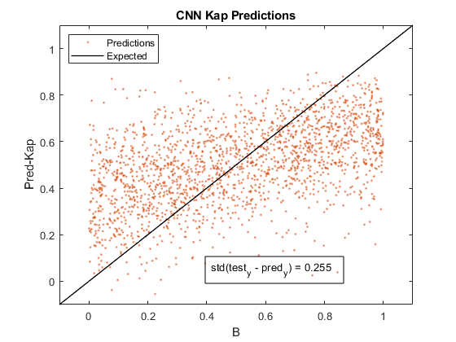
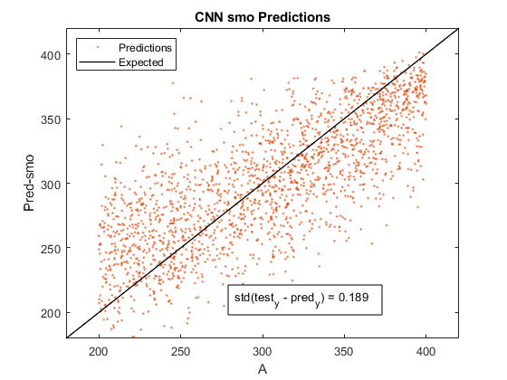
Data10k_SmoKap
5 5 amplitude
1 1 magnetic field
8 8 energy
200 400 smo
2 2 nu
0 1 Kap
40 40 ld
1 1 ni density
Initial Learn = 0.1

